Slide 1
Axis Insurance
Sandhya Nair
November 2020

Slide 2
Objective
Explore the dataset and extract insights using Exploratory Data Analysis
Prove (or disprove) that the medical claims made by the people who smoke is greater than those who don't
Prove (or disprove) with statistical evidence that the BMI of females is different from that of males.
Using Statistical evidence verify if the proportion of smokers is significantly different across different regions
Using Statistical evidence verify if the mean BMI of women with no children, one child, and two children are the same

Slide 3
Data Information
Data contains information about the policy holder
Variable | Description
Age | Age of primary beneficiary
Sex | Policy holders gender
BMI | Body Mass Index
Smoker | Insured is smoker or not
Children | No of children covered by insurance plan
Region | Beneficiary's place of residence
Charges | Individual medical costs billed to health insurance
Observations | Variables
1338 | 7
Note: There are no missing values in the dataset The children column has been converted to category from integer type Performed Label encoring of categorical data

Slide 4
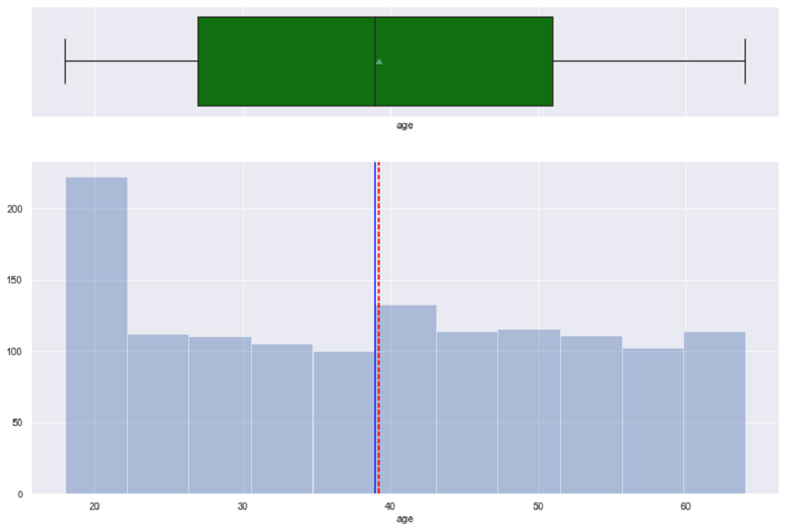
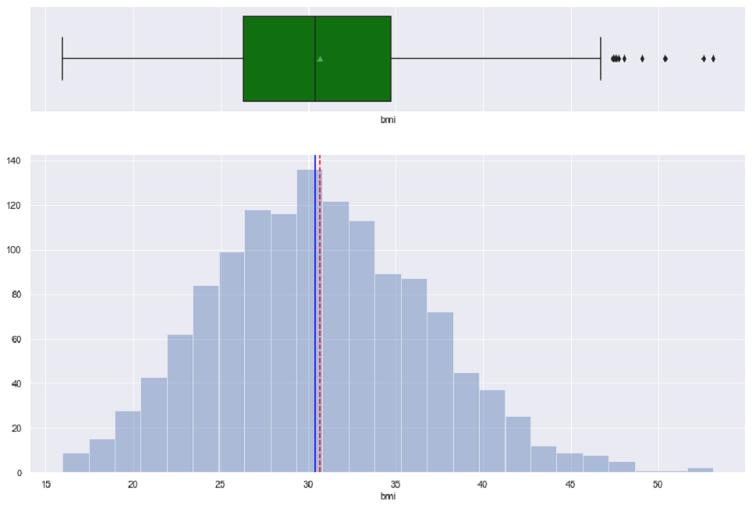
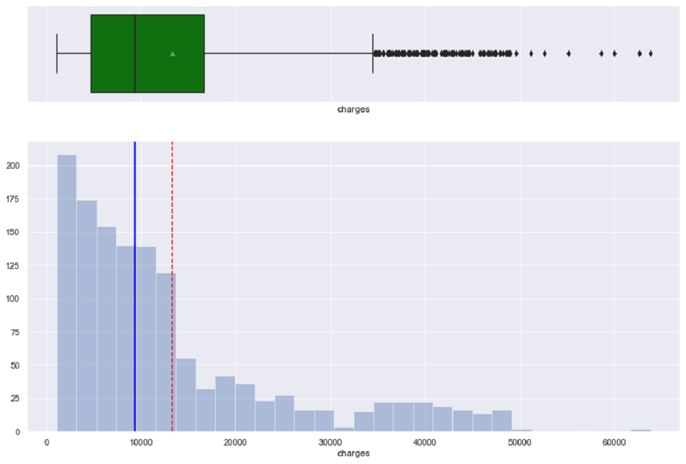
Exploratory Data Analysis-Age, BMI,Charges
Age BMI Charges
The mean and median of Age
are approx. equal
75% of primary
beneficiaries are below age 51
50 percent of the people have BMI of around 30
which is more than the ideal BMI
We can see many outliers for this variable
Mean and median are aprrox. equal
BMI ranges from values 16 to 53
The distribution is right skewed
There are many outliers present for this variable
50% of people have charges around 9000 billed to health insurance

Slide 5
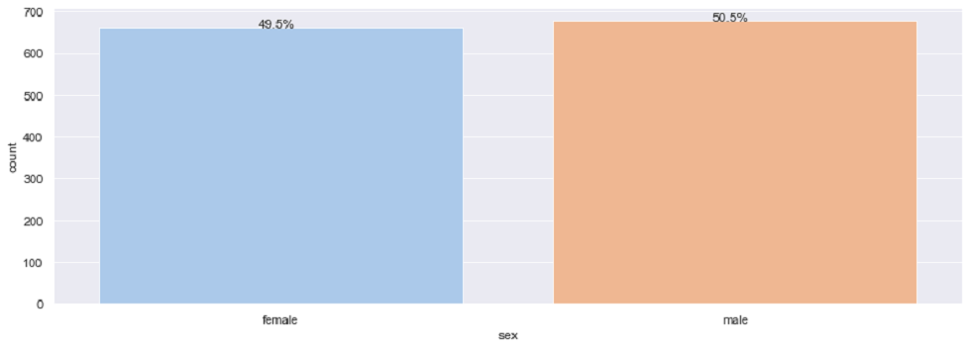
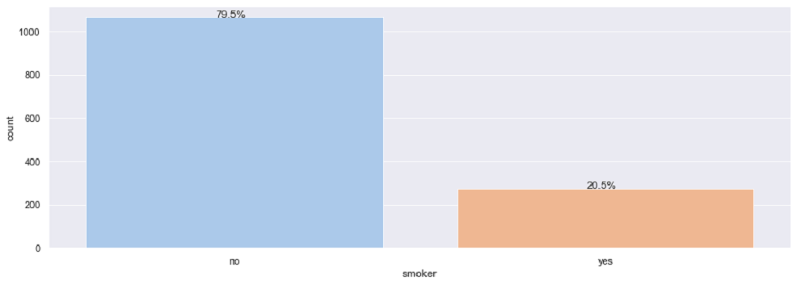
Exploratory Data Analysis-Sex,Smoker
Sex
Smoker
There are more male policy
holders than female policy holders
More number of insured are non- smokers(79.5%) than smokers(20.5%)

Slide 6
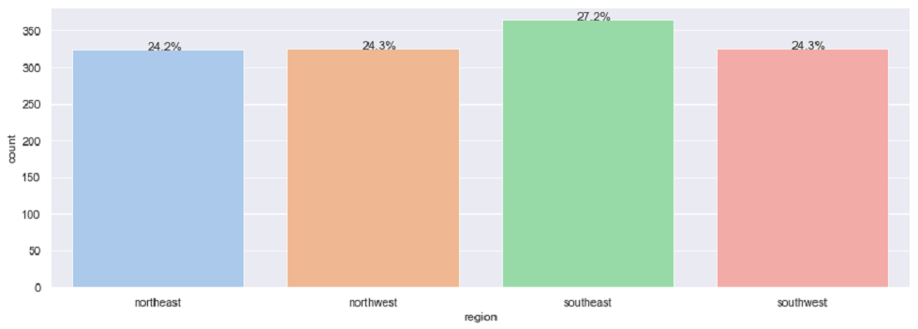
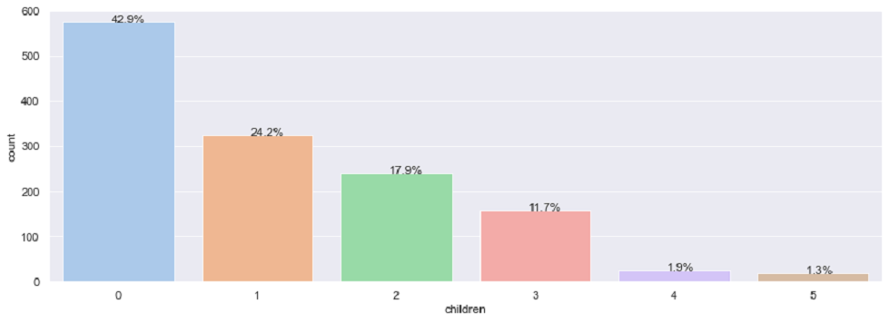
Exploratory Data Analysis-Region,Children
Region
Children
Higher number of people under the insurance live in the south east region(27.2%),followed by southwest and northwest regions(both 24.3%)
Northeast has the lowest number of people(24.2%) living who are insured in the policy
The max number of children covered by insurance is 5
42.9% people have no children covered by the insurance plan

Slide 7
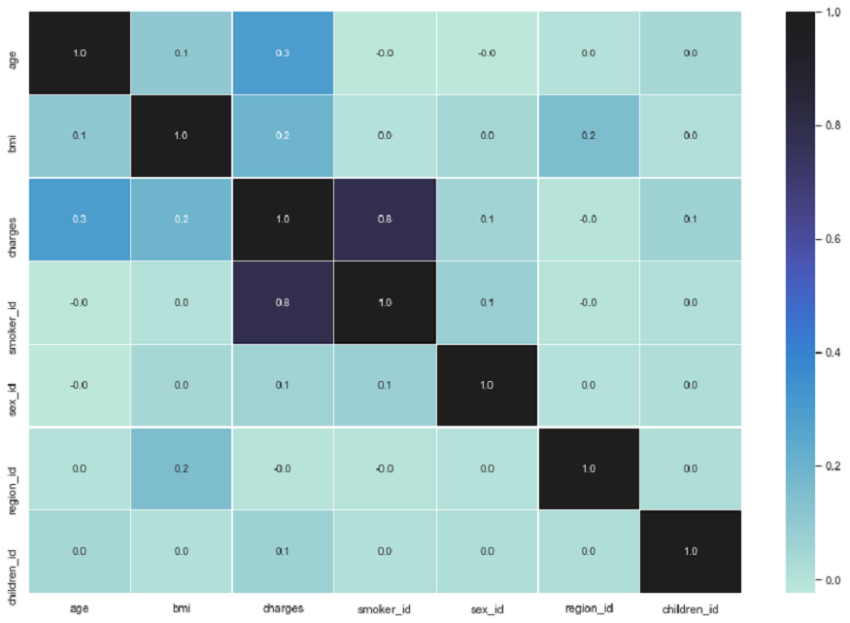
Exploratory Data Analysis-Correlation matrix
Observations:
There is a high positive correlation
between smoking and charges indicating
that being a smoker leads to very high
medical charges
There is a weak positive correlation
between age and charges indicating charges
increase slightly with age
There is a weak positive correlation
between BMI and charges indicating
charges increase slightly with higher BMI
Other variables have significantly low
correlation with each other

Slide 8
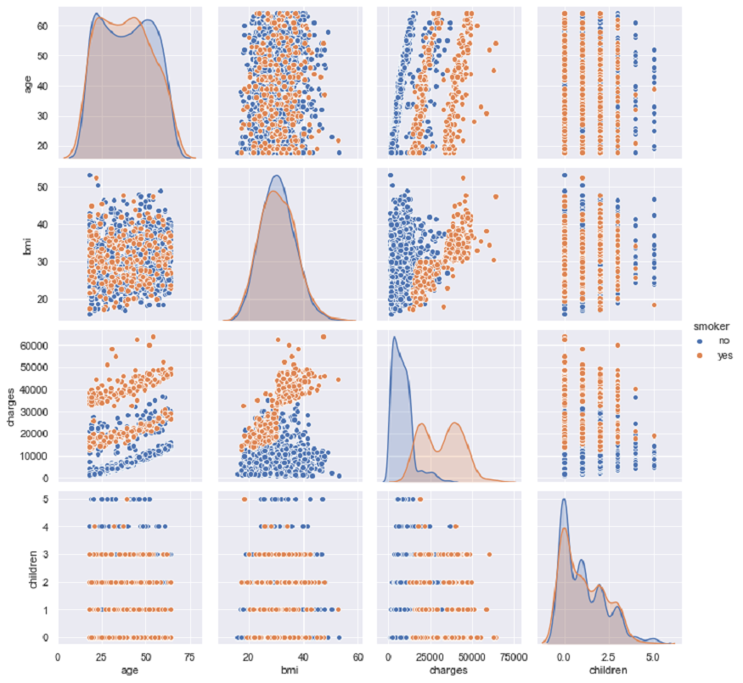
Exploratory Data Analysis – Pair plot
Observations:
We can see the insured who regularly smokes
has higher charges billed to insurance
Also with age charges billed to insurance
increases

Slide 9
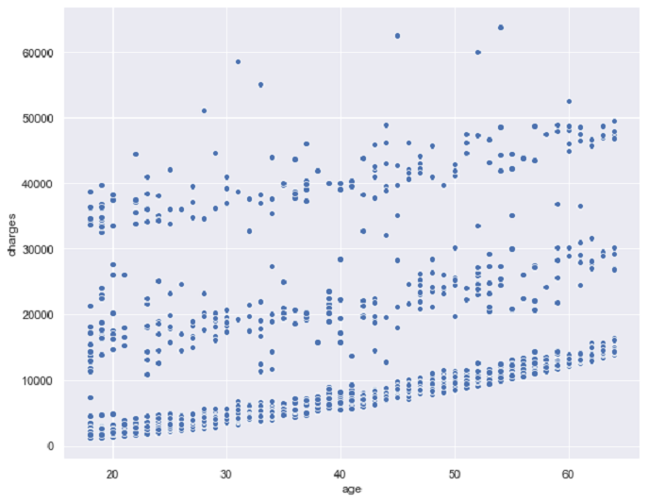
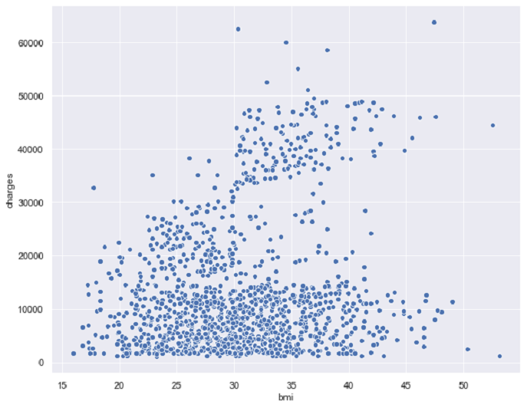
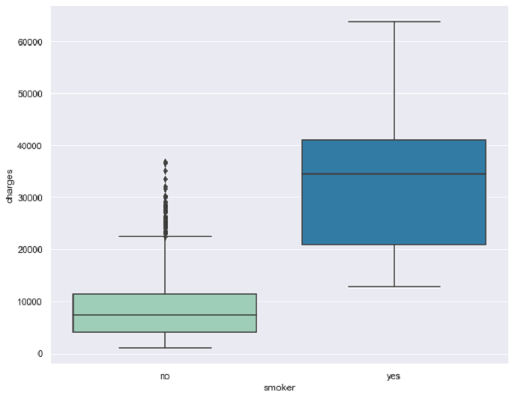
Exploratory Data Analysis:Charges with Age ,BMI,smoker
Charges vs Age Charges vs BMI Charges vs Smoker
Observations:
Medical costs increases with age.But there could be other variables along with age that would make the medical cost high.
Need to analyze further
Observations:
Charges are higher for people with BMI greater than 30
Observations:
Here we can see smokers have significantly higher insurance charges compared to non smokers and the min amount for smokers is higher than 10000
There are some outliers in terms of charges for non smokers.Need further analysis

Slide 10
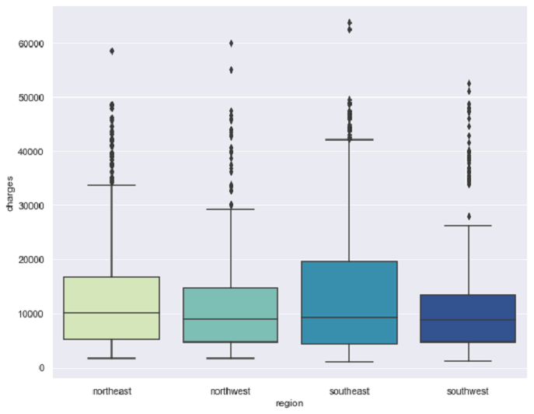
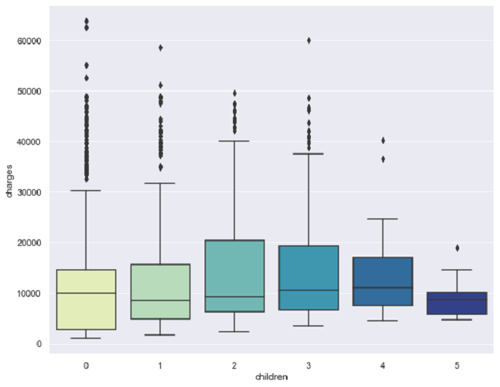
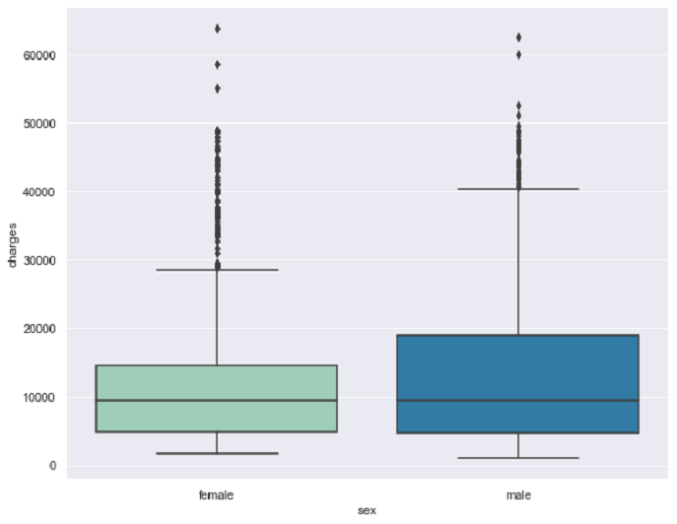
Exploratory Data Analysis:Charges with Region,Children,Sex
Charges vs Region Charges vs Children Charges vs Sex
Observations:
southeast region has some of the higher medical costs.Also for this region we can see outliers with more than 60000 cost
Observations:
Having 5 children insured contributes to less charges.Charges are more when 2 children are insured
Observations:
Males have higher charges than females.But we can also see that its a female who has the highest charges of above 60000

Slide 11
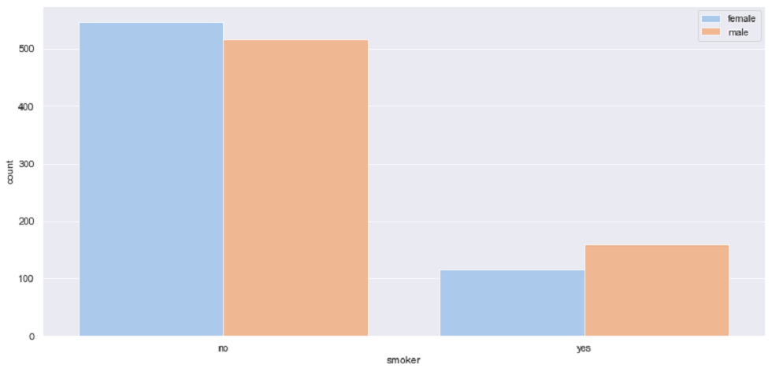
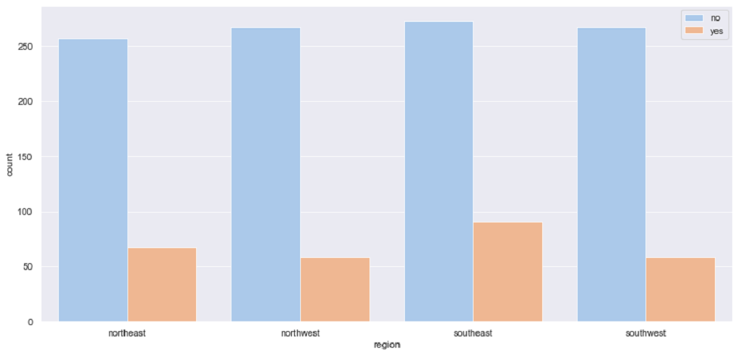
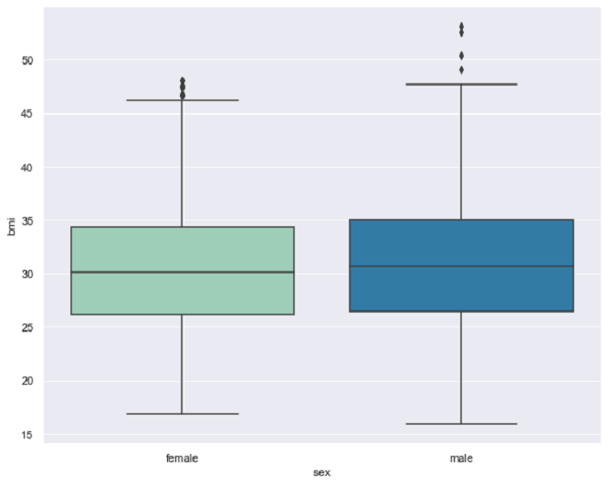
Exploratory Data Analysis:Analyzing variables of policy holders
Smoker vs Sex
Smoker vs Region
BMI vs Sex
There are more male smokers than female smokers which could be contributing to the higher charges among men
There are slightly more number of smokers in the southeast region
Non smokers are comparatively same across regions with slight differences
BMI of males and females are approx. equal.We can also see few outlier values (>50 BMI) for males

Slide 12
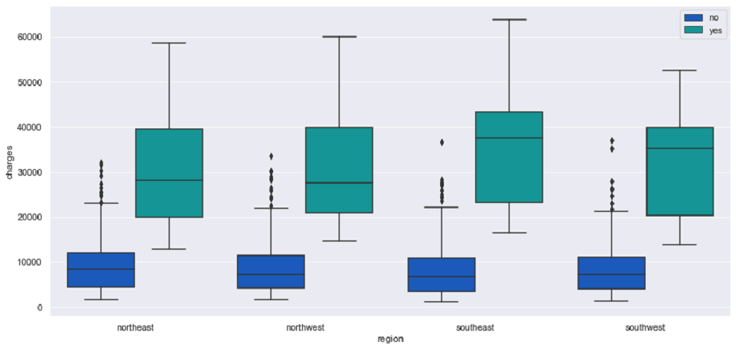
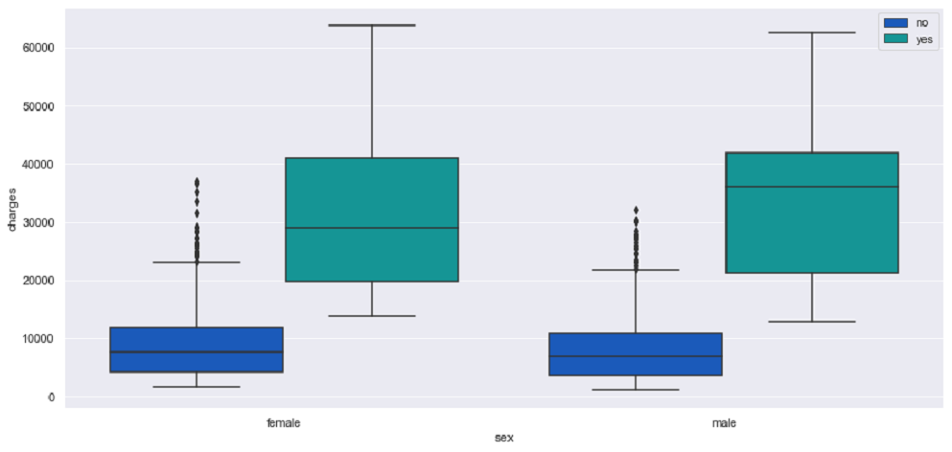
Exploratory Data Analysis:Analyzing variables of policy holders
Charge vs Region vs Smoker Charge vs Sex vs Smoker
All of the regions have higher charges for smokers with charges being highest for southeast region
Charges for both male and female smokers are much higher than non smokers

Slide 13
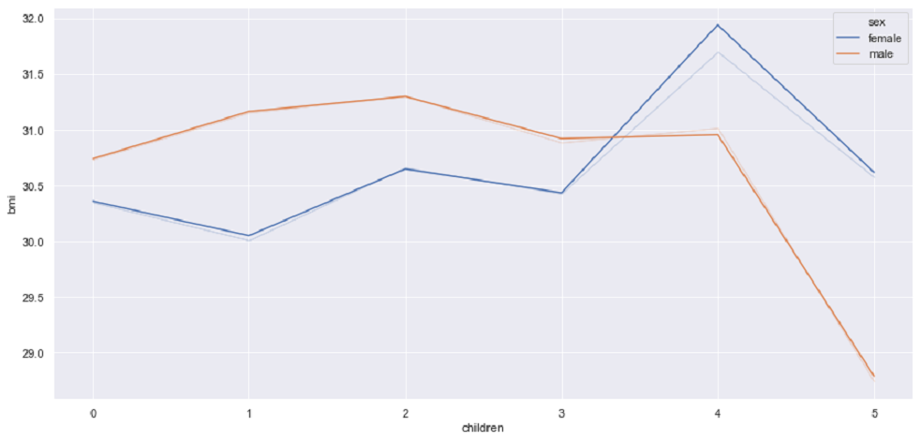
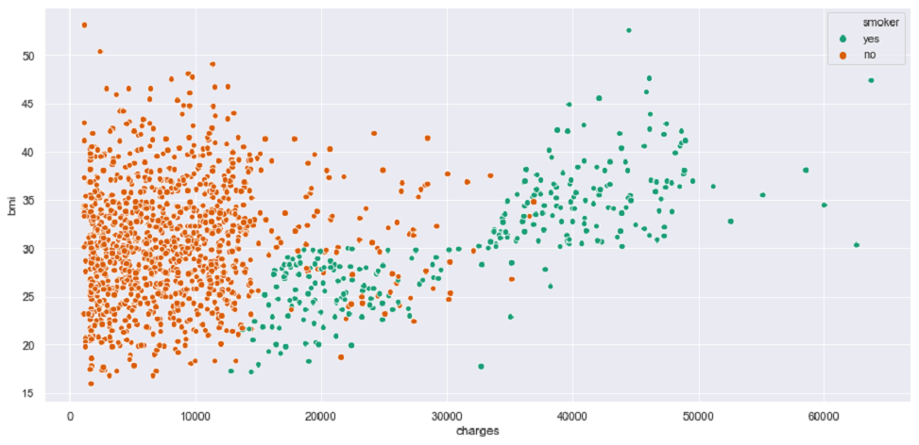
Exploratory Data Analysis:Analyzing variables of policy holders
BMI vs Children vs Sex Smoker vs BMI vs Charges
BMI is highest for women with 4 children
Charges for smokers are higher compared to non smoker

Slide 14
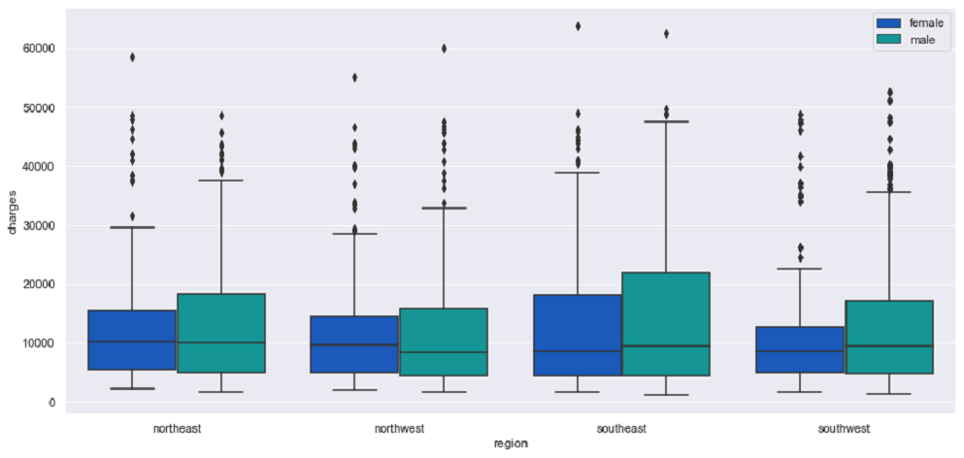
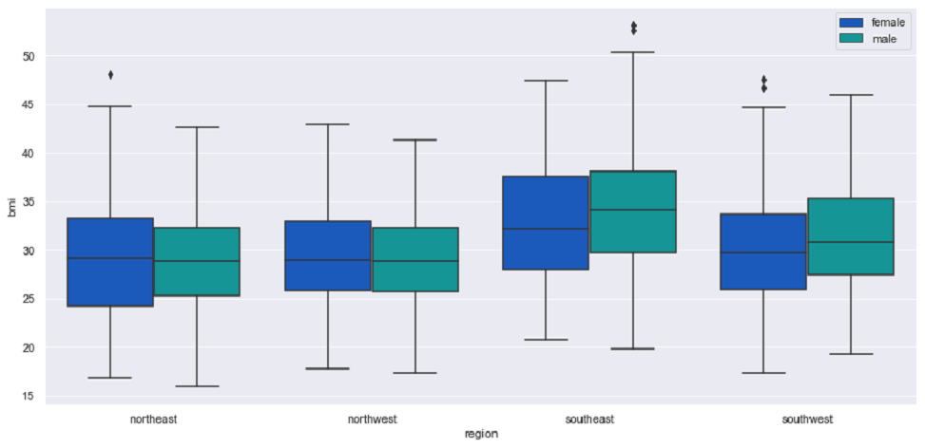
Exploratory Data Analysis:Analyzing variables of policy holders
Charge vs Region vs Sex BMI vs Region vs Sex
For all of the regions we can see that charges are higher for males than females with southeast region having the highest charges for both males and females
Southeast region has highest BMI for both males and females than all other regions

Slide 15
Customer Characteristics Across Regions
South East Region
Most of the Insured fall in the Age group of mid 20's to 50s
Higher number of male policy holders.Also higher number of males compared to southwest and northeast regions
50% of the policy holders does not have ideal BMI.The BMI number is higher compared to other 3 regions
Frequency of non smokers is higher.Has the highest number of non smokers compared to other regions
Has the highest charges for individual medical cost
South West Region
Most of the Insured fall in the Age group of upper 20's to 50s
Higher number of male policy holders
50% of the policy holders does not have ideal BMI but better compared to southeast region
Frequency of non smokers is higher
Has the lowest max charges compared to other regions
North East Region
Most of the Insured fall in the Age group of upper 20's to 50s
Higher number of male policy holders
BMI of policy holders is better compared to southeast and southwest regions
Frequency of non smokers is higher
North West Region
Most of the Insured fall in the Age group of mid 20's to 50s
Higher number of female policy holders
BMI of policy holders is better compared to other regions
Frequency of non smokers is higher

Slide 16
Conclusions based on EDA
Factors that lead to higher medical charges are age, BMI and also if the policy holder is a regular tobacco user led to having increased charges.Charges are very high for smokers compared to non smokers
Males have higher charges than females
There is no significant difference between BMI of males and females
Smoking is higher in males than females and this could be one of the reasons for higher medical cost among men
Among the regions southeast region has the highest number of smokers and also people with higher BMI's .This would explain the higher amount of charges we see for this region compared to the other regions
Women with 4 children has the highest BMI

Slide 17
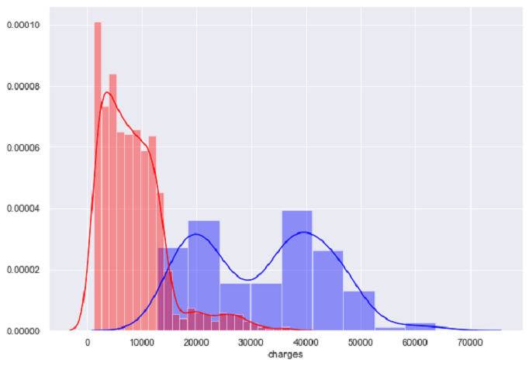
Hypothesis Testing
1.Statistical Analysis to Prove (or disprove) that the medical claims made by the people who smoke is greater than those who don't
Null hypothesis 𝐻0 : medical claims made by people who smoke is less than or equal to people who do not smoke
Alternate hypothesis 𝐻𝐴 :medical claims made by people
who smoke is greater than people who do not smoke
Significance level(𝛼) =0.05
Distribution and test Statistic used : t distribution and the
2 sample t test
p-value :4.1357179210886093e-283.Based on p-value
we have rejected the null hypothesis.
Conclusion:So at 95% confidence level, there is sufficient evidence to prove that medical claims made by people who smoke is greater than people who do not smoke

Slide 18
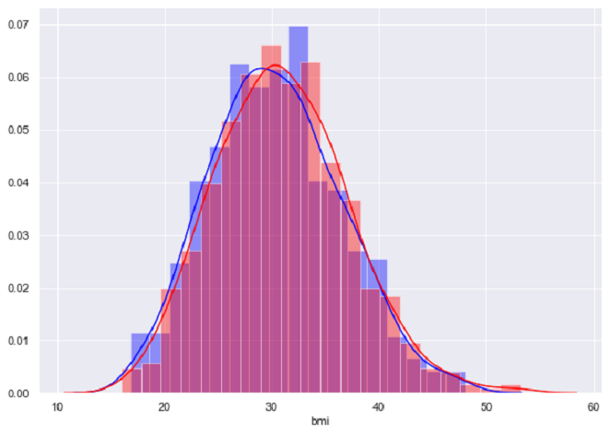
Hypothesis Testing
2.Prove (or disprove) with statistical evidence that the BMI of females is different from that of males.
Null hypothesis 𝐻0 : BMI of females is same as BMI of males
Alternate hypothesis 𝐻𝐴 :BMI of females is different from BMI of males
Significance level(𝛼) =0.05
Distribution and test Statistic used : t distribution and the 2 sample
t test
p-value :0.08997637178984932.Based on p-value we have failed
to reject the null hypothesis.
Conclusion: So at 95% confidence level, there is sufficient
evidence to prove that BMI of females is same as BMI of males¶

Slide 19
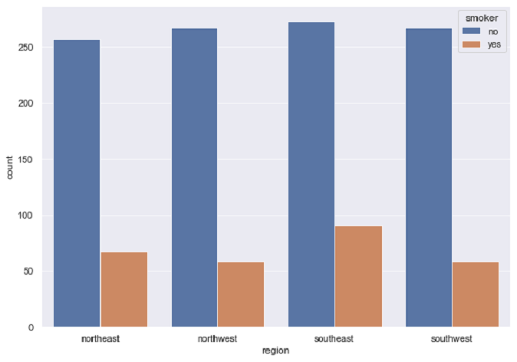
Hypothesis Testing
3.Statistical analysis to verify if the proportion of smokers significantly different across different regions
Null Hypothesis :𝐻0 :Proportion of smokers does not differ
significantly across regions
Alternate Hypothesis 𝐻𝐴 :Proportion of smokers differ
significantly across region
Significance level(𝛼) =0.05
Distribution and test Statistic used :Chi-sq Test
p-value:0.06171954839170547.Based on p-value
we have failed to reject the null hypothesis.
Conclusion : At 95% confidence we fail to reject the
null hypothesis which implies proportion of smokers does not
differ significantly across regions

Slide 20
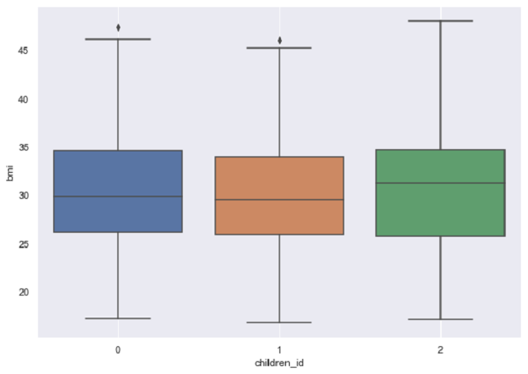
Hypothesis Testing
4.Statistical analysis to verify if the mean BMI of women with no children, one child, and two children the same?
Null Hypothesis 𝐻0 :Mean BMI of women with no children, one child, and two children are the same 𝜇1 = 𝜇2 =𝜇3
Alternate Hypothesis 𝐻𝐴:Mean BMI of women with no children
, one child, and two children are not the same
Significance level(𝛼) =0.05
Distribution and test Statistic used :One-Way ANOVA test
p-value:0.715858.Based on p-value
we have failed to reject the null hypothesis.
Conclusion:At 95% confidence level there is no difference in
the Mean BMI of women with
no children, one child, and two children.

